Slide 1

An Energy Aware Edge Priority-based Scheduling Algorithm for Multiprocessor Environments Authors: Ashish Kumar Maurya and Anil Kumar Tripathi Conference: PDPTA’18, Las Vegas, USA Paper ID: PDP3408
Presented by:
Anil Kumar Tripathi
Professor
Dept. of Computer Science & Engineering,
Indian Institute of Technology (BHU), Varanasi, INDIA

Slide 2
Contents
Introduction
Related work
System model and problem formulation
The proposed algorithm
Experimental results
Conclusions
References

Slide 3
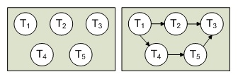
Introduction
Multiprocessors
New challenges in multiprocessors
Dynamic Voltage Frequency Scaling (DVFS)
A parallel application
Proposed an algorithm called EAEPS
It reduces the energy consumption by zeroing the edges of high priorities.
It is an energy aware version of our EPS algorithm.

Slide 4
Introduction
Objective
“To develop an energy-aware scheduling algorithm which aims to reduce power consumption by exploiting DVFS technique.“
Contributions
The idea of edge prioritization leads to meaningful clustering
The work fruitfully achieves minimization of energy consumption
A simulation study is performed for benchmark task graphs

Slide 5
Related Work
Task scheduling algorithms
List scheduling algorithms
Duplication-based scheduling algorithms
Clustering-based scheduling algorithms
Energy aware scheduling algorithms

Slide 6



System Model and Problem Formulation
Energy Model
Processors have several voltage and frequency levels, and a scheduling algorithm may choose the appropriate voltage and frequency to save energy.
Processor Model
Processors are enabled with software controlled DVFS
Application Model
Directed Acyclic Graph (DAG)

Slide 7

The Proposed Algorithm
Edge prioritization
Concept of edge priority in Sarkar’s algorithm
Our concept of edge prioritization
Clustering
Merging of two tasks or clusters
The order among tasks within a cluster is decided by their bottom-levels.

Slide 8



The Proposed Algorithm
Voltage scaling of non-critical tasks
Slack of a task is defined as the amount of time the task can be delayed without delaying the makespan.
where LFT is latest finish time, EST is earliest start time and ET is execution time of the task
New execution time of the task:
When a processor executes a non-critical task, it first calculates its slack and then its new execution time. After that it attempts to scale its operating frequency

Slide 9
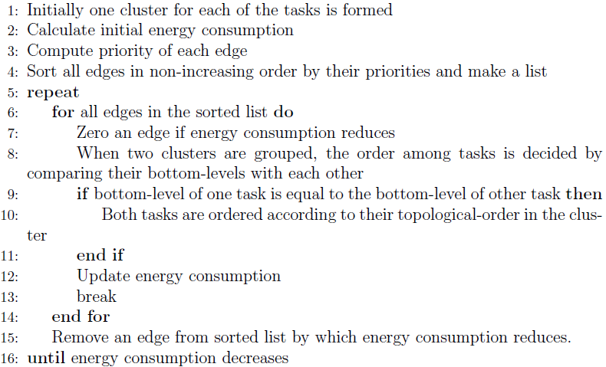
The Proposed Algorithm
EAEPS Algorithm

Slide 10
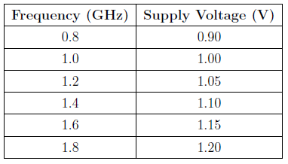
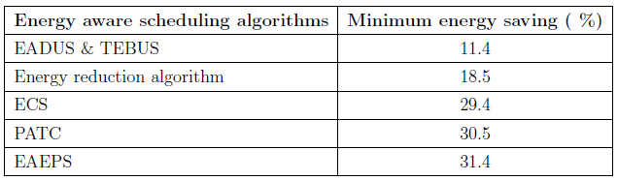
Experimental Results
Performed simulation for some benchmark task graphs given by Davidovic and Crainic.
Results of EAEPS are compared with EADUS & TEBUS, Energy reduction algorithm, ECS and PATC.
Frequency and supply voltages used in this work

Slide 11
Conclusions
Proposed an energy-aware version of our EPS algorithm called EAEPS that aims at reducing energy consumption by exploiting DVFS technique and outperforms the four energy-aware scheduling algorithms.
The simulation results show that EAEPS achieves up to 31.4 % energy saving.

Slide 12
References
[1] J. Jiang, Y. Lin, G. Xie, L. Fu, and J. Yang, “Time and energy optimization algorithms for the static scheduling of multiple workflows in heterogeneous computing system,” Journal of Grid Computing, vol. 15, no. 4, pp. 435-456, 2017.
[2] L. Wang, S. U. Khan, D. Chen, J. Kołodziej, R. Ranjan, C-Z Xu, et al., “Energy-aware parallel task scheduling in a cluster,” Future Generation Computer Systems, vol. 29, no. 7, pp. 1661-1670, 2013.
[3] A. K. Maurya, and A. K. Tripathi, “An edge priority-based clustering algorithm for multiprocessor environments,” Concurrency and Computation: Practice and Experience.
[4] O. Sinnen, Task Scheduling for Parallel Systems, John Wiley & Sons; 2007.
[5] A. K. Maurya, and A. K. Tripathi, “Performance comparison of HEFT, Lookahead, CEFT and PEFT scheduling algorithms for heterogeneous computing systems,” In Proceedings of the Seventh International Conference on Computer and Communication Technology 2017 (ICCCT’17), ACM, pp.128–132, 2017.
[6] A. K. Maurya, and A. K. Tripathi, “On benchmarking task scheduling algorithms for heterogeneous computing systems,” The Journal of Supercomputing, 2018.
[7] G. Terzopoulos, and H. D. Karatza, “Power-aware Bag-of-Tasks scheduling on heterogeneous platforms,” Cluster Computing, vol. 19, no. 2, pp. 615-631, 2016.
[8] Z. Zong, A. Manzanares, X. Ruan, and X. Qin, “EAD and PEBD: two energy-aware duplication scheduling algorithms for parallel tasks on homogeneous clusters,” IEEE Transactions on Computers, vol. 60, no. 3, pp.360-374, 2011.
[9] Y. C. Lee, and A. Y. Zomaya, “Minimizing energy consumption for precedence-constrained applications using dynamic voltage scaling,” 9th IEEE/ACM International Symposium on Cluster Computing and the Grid, 2009 (CCGRID'09), IEEE, 2009.
[10] Y. Hu, C. Liu, K. Li, X. Chen, and K. Li, “Slack allocation algorithm for energy minimization in cluster systems,” Future Generation Computer Systems, vol. 74, pp.119-131, 2017.

Slide 13
References
[11] G. Aupy, A. Benoit, and Y. Robert, “Energy-aware scheduling under reliability and makespan constraints,” 19th International Conference on High Performance Computing (HiPC 2012), IEEE, 2012.
[12] H. Kimura, M. Sato, M., Y. Hotta, T. Boku, and D. Takahashi, “Emprical study on reducing energy of parallel programs using slack reclamation by dvfs in a power-scalable high performance cluster,” In IEEE International Conference on Cluster Computing, IEEE, 2006.
[13] N. Kaur, S. Bansal, and R. K. Bansal, “Duplication-controlled static energy-efficient scheduling on multiprocessor computing system,” Concurrency and Computation: Practice and Experience, vol. 29, no. 12, 2017.
[14] J. Mei, K. Li, and K. Li, “Energy-aware task scheduling in heterogeneous computing environments,” Cluster Computing, vol. 17, no. 2, pp. 537-550, 2014.
[15] X. Tang, and W. Tan, “Energy-Efficient Reliability-Aware Scheduling Algorithm on Heterogeneous Systems,” Scientific Programming 2016, p.14, 2016.
[16] M. Sharifi, Sa. Shahrivari, and H. Salimi, “PASTA: a power-aware solution to scheduling of precedence-constrained tasks on heterogeneous computing resources,” Computing, vol. 95, no. 1, pp. 67-88, 2013.
[17] R. Ge, X. Feng, K. W. Cameron, “Performance-constrained distributed DVS scheduling for scientific applications on power-aware clusters,” in: SC, 2005, p. 34.
[18] M. Y. Lim, V. W. Freeh and D. K. Lowenthal. “Adaptive, transparent frequency and voltage scaling of communication phases in MPI programs,” In proceedings of the ACM/IEEE SC 2006 conference, IEEE, pp. 14-14. 2006.
[19] D. Kadamuddi, J.J. P. Tsai, “Clustering algorithm for parallelizing software systems in multiprocessors environment,”, IEEE Transactions on Software Engineering, vol. 26, no. 4, pp. 340-361, 2000.
[20] T. Davidovic, T. G. Crainic, “Benchmark-problem instances for static scheduling of task graphs with communication delays on homogeneous multiprocessor systems,” Computers & Operations Research, vol. 33, no. 8, pp. 2155–2177, 2006.

Slide 14

Thank You

